Slide 1
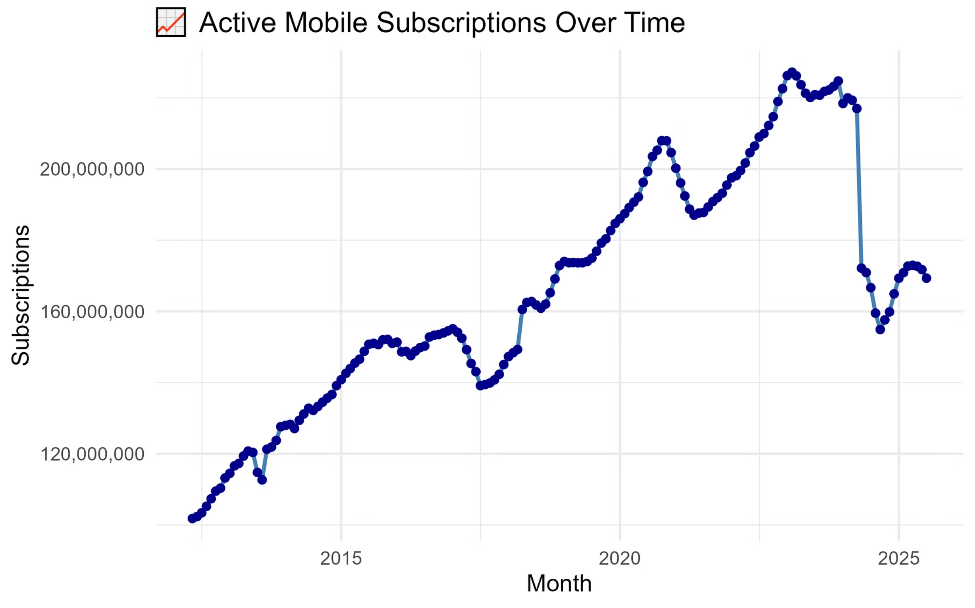
Nigeria’s Telecom Growth Journey
For over two decades, Nigeria’s telecom industry has been one of the fastest growing in Africa. Subscriptions skyrocketed from just a few million in the early 2000s to well over 200 million. This explosive growth was not just about phones, it was about connecting people, businesses, and entire communities. What you are seeing here is more than numbers, it is a story of digital transformation.
Subscriptions Over Time: The Growth Story

Slide 2
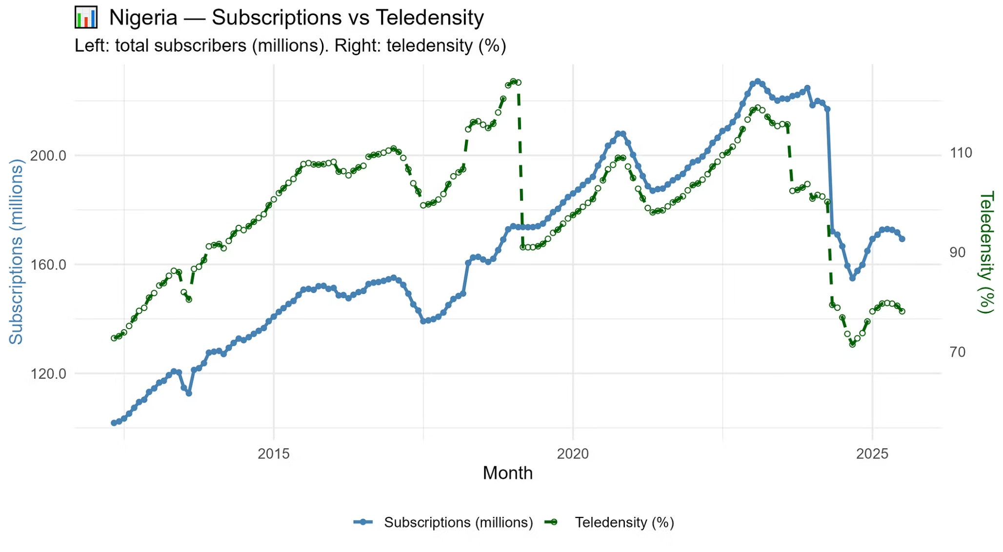
How Subscriptions and Teledensity Move Together
Notice how both lines move in tandem, climbing year after year. Teledensity tells us how widespread phone access is relative to the population. The takeaway is clear. Nigeria was on an unstoppable rise until around 2021. Suddenly, the momentum shifted. Growth slowed, and then the curve started bending downward. This was my first clue that something major had happened.

Slide 3
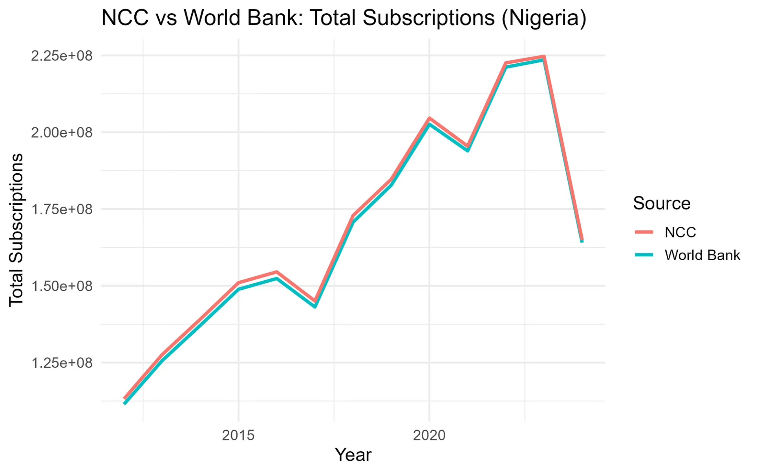
Cross-Validation: NCC vs. World Bank Totals
Comparing NCC with World Bank data confirms consistency. Minor differences exist due to methodology, but both show strong growth until 2021.

Slide 4
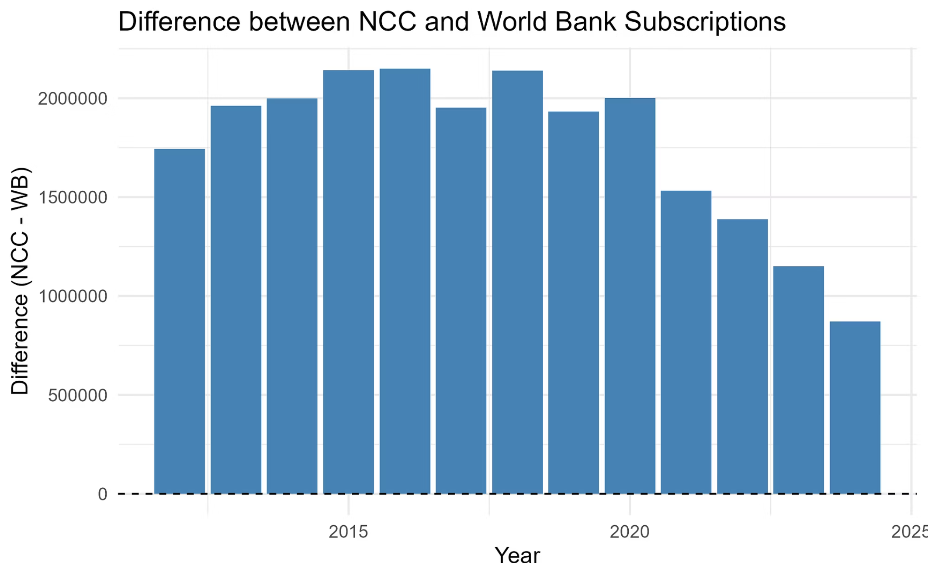
Measuring the Gap: NCC vs. World Bank Differences
Differences between NCC and WB data are marginal and mostly reflect reporting adjustments, not major discrepancies. This validates reliability of the NCC dataset. These are not red flags; in fact, they strengthen confidence in the NCC dataset because independent validation shows the same trajectory.

Slide 5
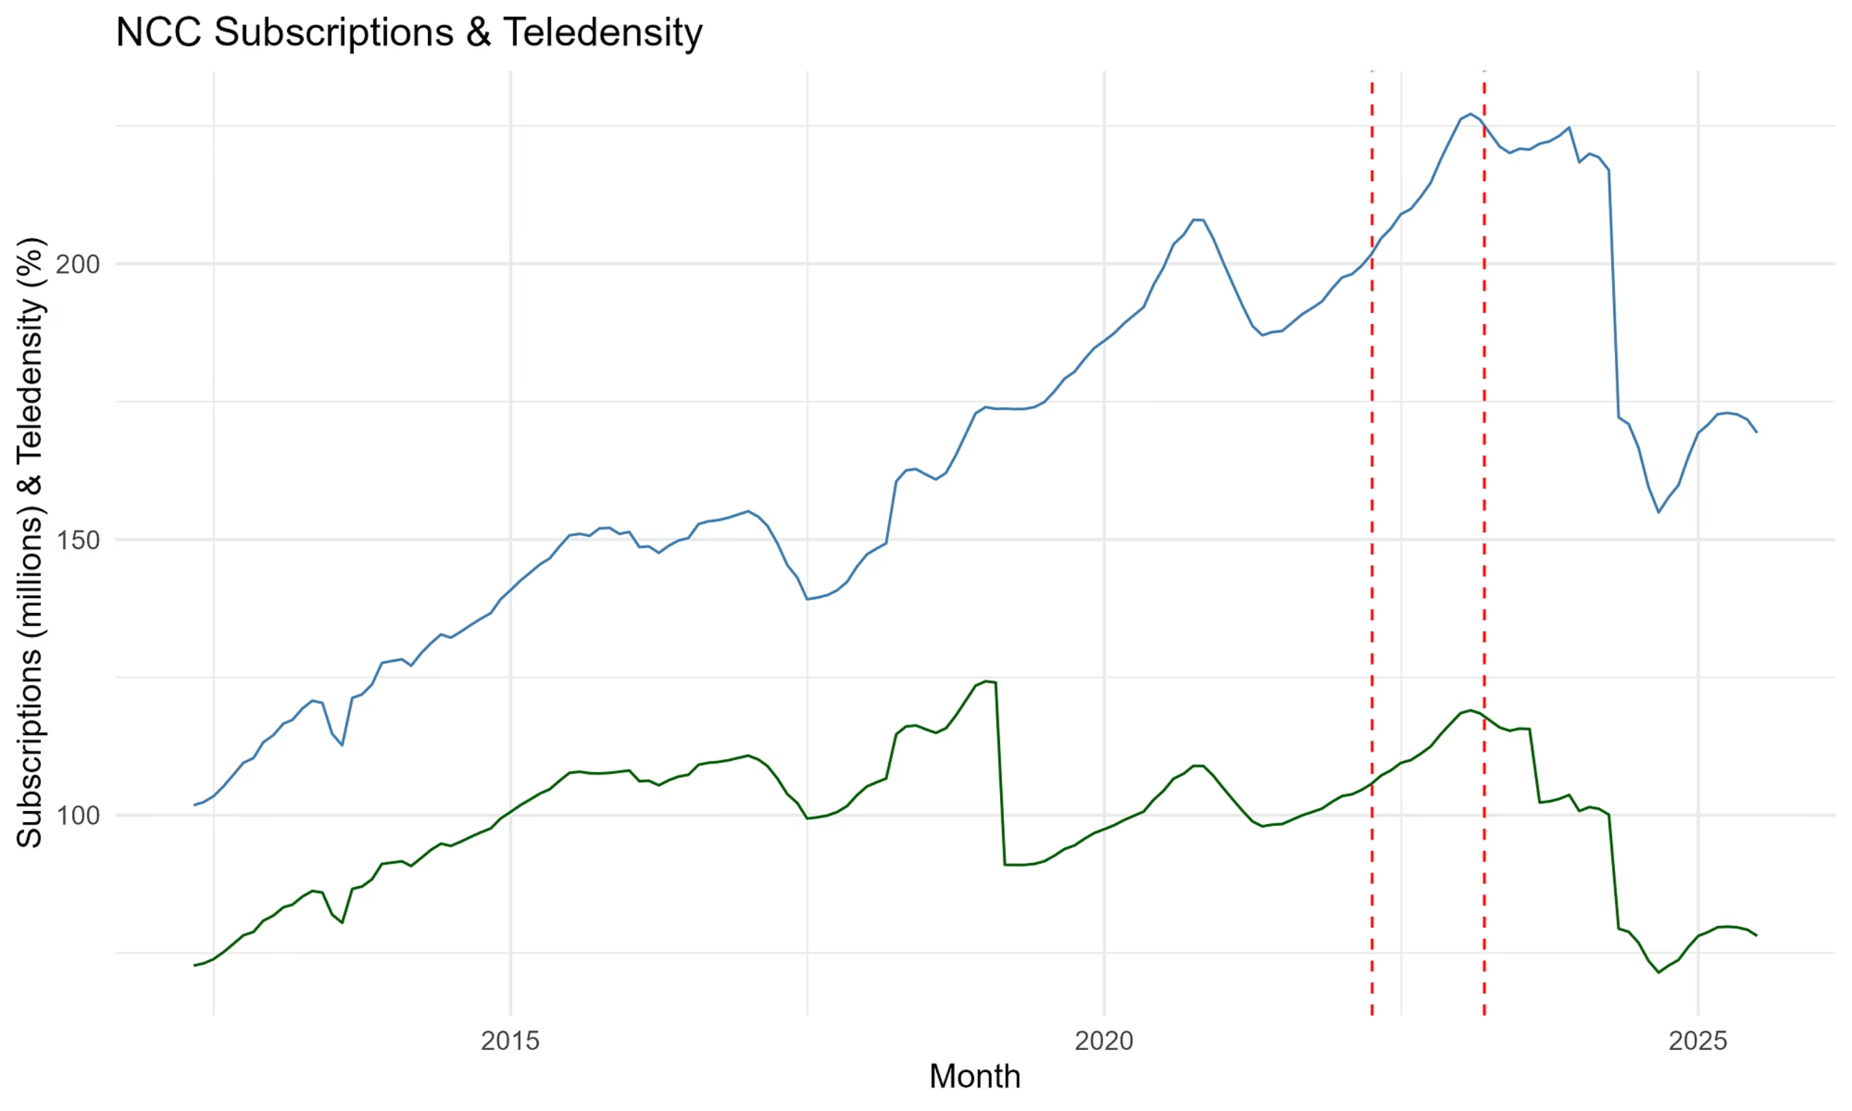
Policy Shock: The SIM-NIN Enforcement Effect
So what caused the sharp decline
Subscription and teledensity levels fell sharply after April 2022 and March 2023, aligning with stricter SIM-NIN linkage enforcement. Regulatory intervention, not just market saturation, drove the decline.

Slide 6
Before-and-After: Quantifying the Drop
Impact before vs. 90 days after enforcement
Finally, the impact table quantified it. Analysis shows double-digit percentage losses within 90 days of enforcement dates. This underscores how policy changes reshaped the telecom landscape in 2023.
Date
Before Subscriptions
After Subscriptions
% Change
01/04/2022
201670650
208969445
3.6
01/03/2023
226161713
220086951
-2.7

Slide 7
Closing Reflection: What This Means for Nigeria’s Telecoms
For 20 years, Nigeria’s telecom industry was all about growth. What I found is that policy decisions can change the game just as quickly as consumer demand. The recent decline is not the end of the story; it is the start of a new chapter. The real question now is how operators, regulators, and consumers will adapt to this new reality.

